Slide 1




Merck Animal Health Forecasting Project Week 14 Updates
Team: Abhishek Dixit, Benjamin Elbaz,
Anqi Huang, Shuang Wei
Advisor: Kris Iyer
Date: APR 15TH, 2016

Slide 2
Agenda
One Model for all NOBIVAC Skus (Aggregate Level)
Sales Out Results
Sales In Results
Modeling Activyl Sales In and Sales Out
Previous methods won’t work for Activyl
New approach
Questions and Next Step

Slide 3
One Model for all NOBIVAC SKUs
To predict Nobivac Sales Out:
Aggregate all the SKUs’ Sales Out Doses by month
Apply two models and compare performances:
Model 1 – Use only historical Sales Out
Model 2 – Use historical Sales Out & Total Shipments as the external market data
To predict Nobivac Sales In:
Aggregate all the SKUs’ Sales In Doses and Average Inventory Doses by month
Apply four models and compare performances:
Model 1 – Use only historical Sales In
Model 2 – Use historical Sales In & Sales Out model & Inventory model
Model 3 – Use historical Sales In & Sales Out model
Model 4 – Use historical Sales In & Inventory model

Slide 4
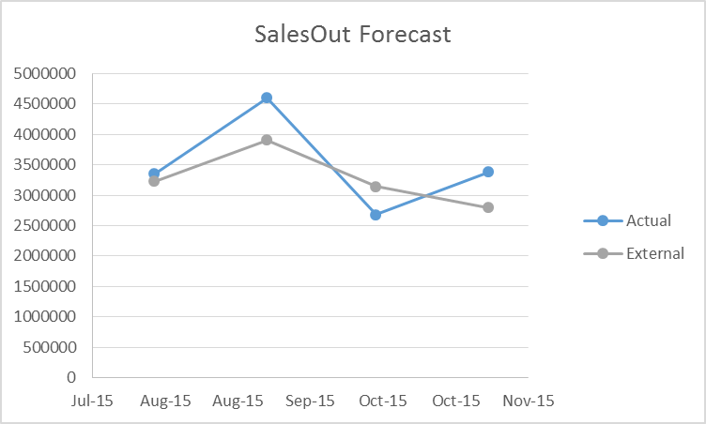
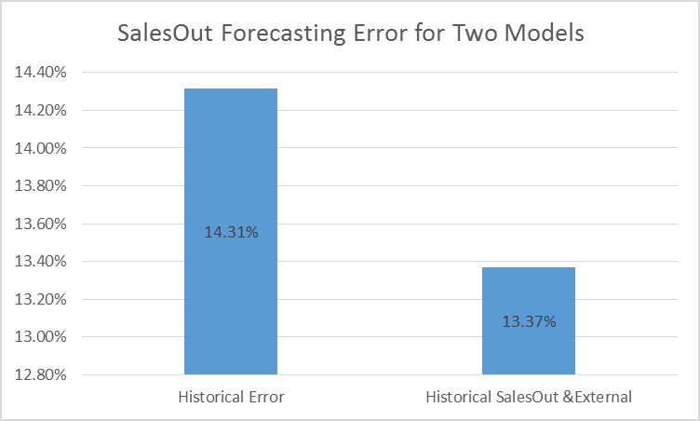
1 – Sales Out Model Analysis
SalesOut Model Selection Best Results:
Historical, SalesOut, & External Model
-Lowest Average Error Rate of 13.37% from 08/2015 to11/2015

Slide 5
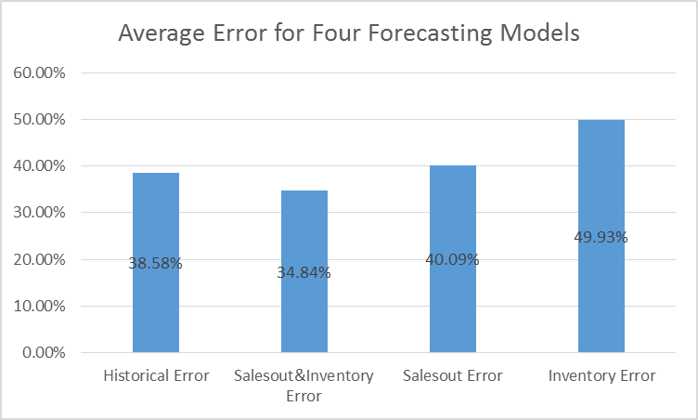
2 – Sales In Model Analysis
SalesIn Model Selection Best Results: Historical, SalesOut, & Inventory Model
-Lowest Average Error Rate of 38.84% in validation data [08/2015 to11/2015]
-In testing data[12/2015-03/2016], average error rate is 46.71%
Validation Results:
Testing Results:
Historical, SalesOut & Inventory Error | Date | Aggregated
 | 8/1/15 | 34.33%
 | 9/1/15 | 19.14%
 | 10/1/15 | 69.37%
 | 11/1/15 | 16.51%
 | Average Error | 34.84%
Historical, SalesOut & Inventory Error | Date | Aggregated
 | Dec-15 | 3.84%
 | Jan-16 | 129.28%
 | Feb-16 | 34.64%
 | Mar-16 | 19.08%
 | Average Error | 46.71%

Slide 6
Modeling Activyl Sales In and Sales Out
Sales In: 2014.01 – 2016.3
Sales Out: 2014.01 – 2015.11
Inventory: 2014.01 – 2015.11
External Market Data: 2014.01 – 2015.11
For each Sku, 23 months’ data in total
- 6 months for training and 17 months for testing

Slide 7
1- Previous Methods Fail
Much fewer data points available
Difficult to analyze Sales Out and Sales In as time series
Inventory going downwards
Analysis on a granular level;
Make full use of inventory data
Monthly Sales In
(2014.1 – 2015. 11)
Monthly Sales Out
(2014.1 – 2015. 11)
Monthly Avg Inventory (2014.1 – 2015. 11)

Slide 8
2- New Approach
Extract Net Sales In and Net Sales Out from Inventory Data
Sales In
Sales Out
Net Sales In
Period 6/3/2014 – 6/17/2014
Net Sales In = (NA, NA, NA, NA, NA, NA, ….., 2, NA)
= 163-161
External Data
Example:
Net Sales out
Inventory
Data
Period 6/3/2014 – 6/17/2014
Net Sales In = (NA, NA, NA, …. NA, 13, NA, …. NA)
= 174-161

Slide 9
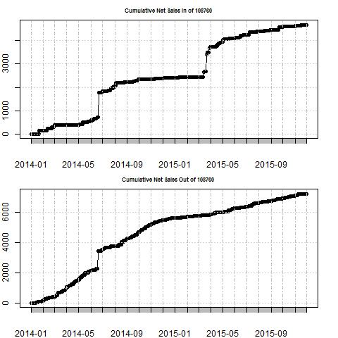
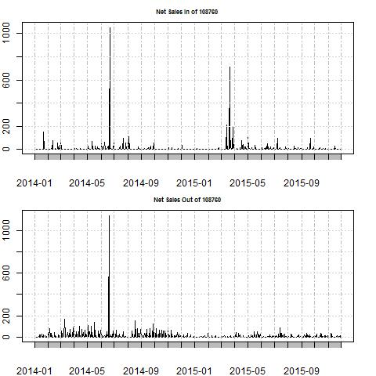
2 – New Approach (Sku 108760 as Example)
Outliers:
Promotion? Price Change?
Data Error?

Slide 10
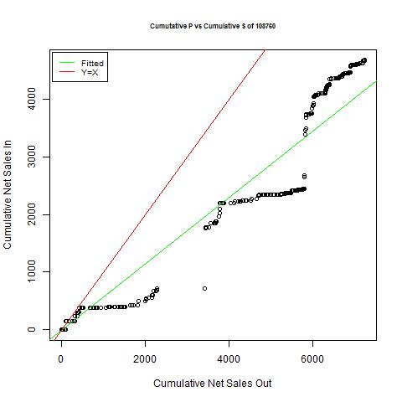
2 – New Approach (Sku 108760 as Example)
Red line
- Supply matches Demand
Green line
- Correlation between Net Sales In and Net Sales Out

Slide 11
3 – Questions and Next Steps
Questions:
1. Errors in inventory data
Records error
Two distributor code correspond to One distributor description
(Example: Sku 108760; 2014-06-21 & 2015-03-21)
2. External Market Data to use for Activyl
Next Step:
Clean inventory data and do outlier analysis
Incorporate Net Sales In and Net Sales Out in model

